Slide 1
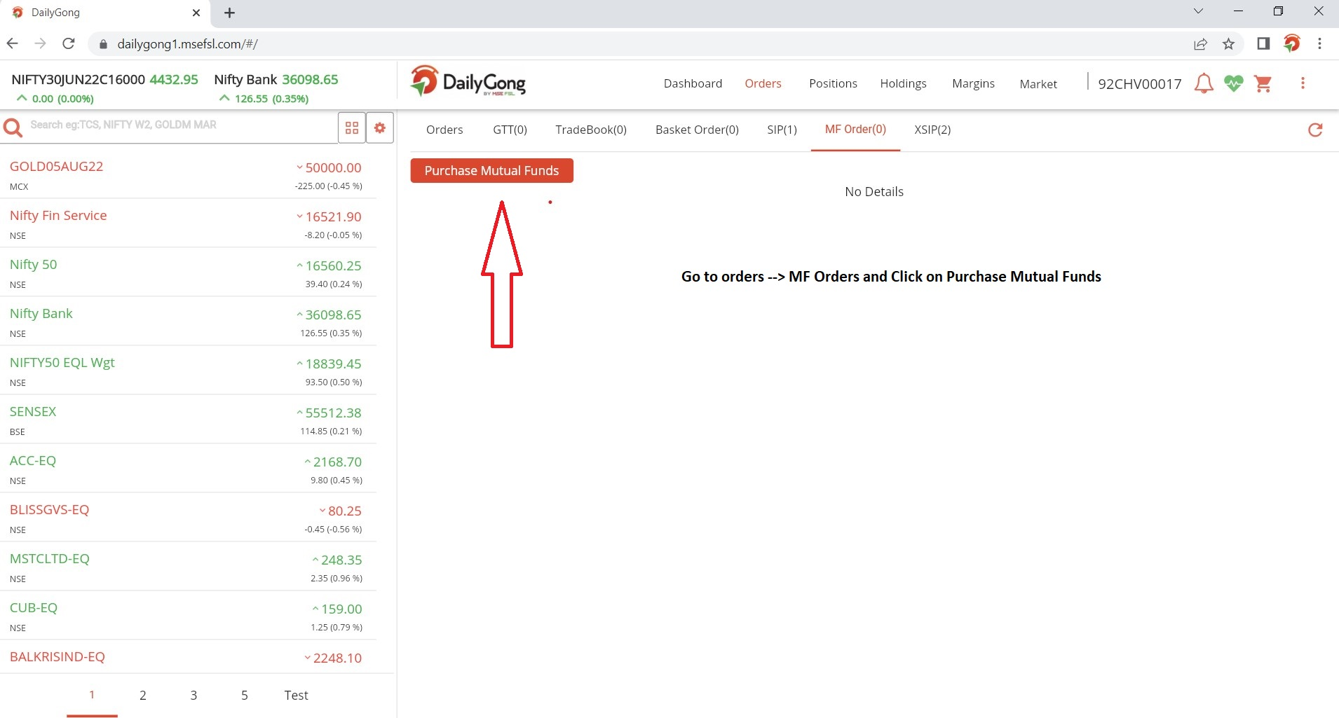
MF LUMP SUM PURCHASE

Slide 2
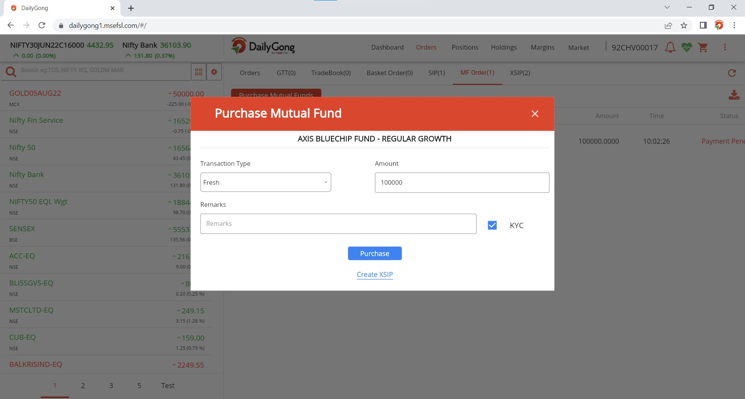

Slide 3
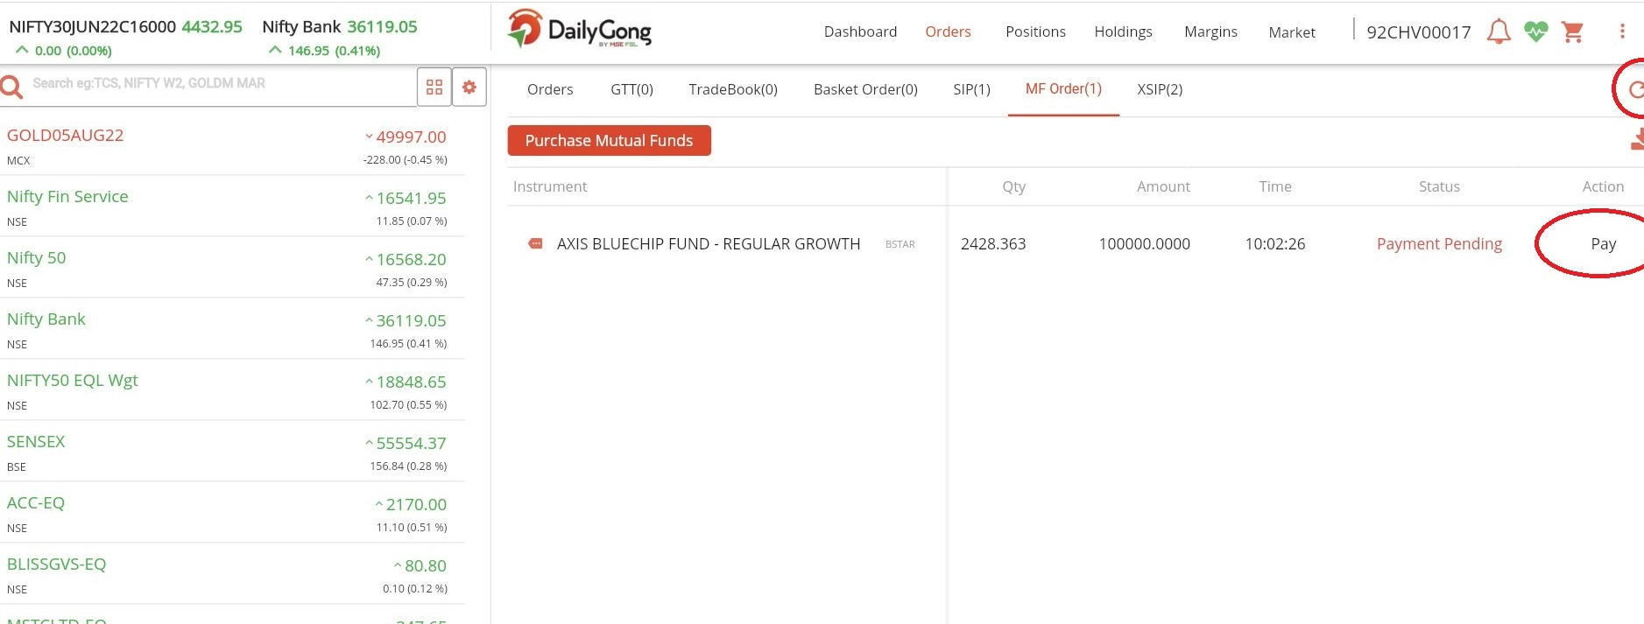
Click on Pay to complete the payment online

Slide 4
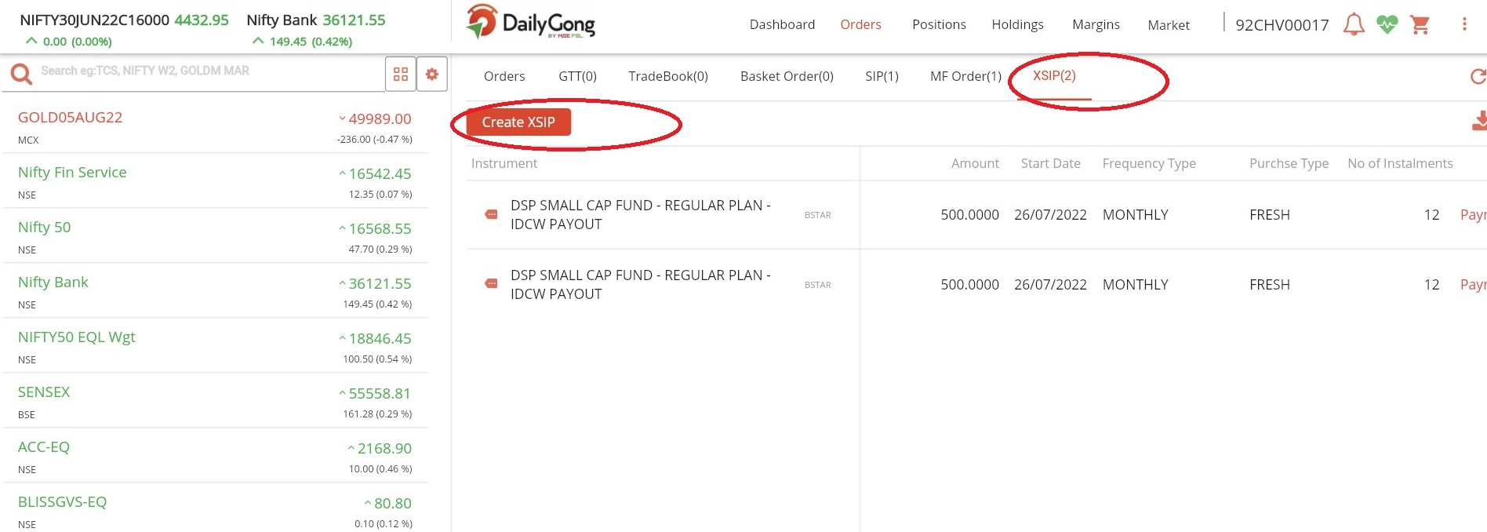
SIP REGISTRATION

Slide 5
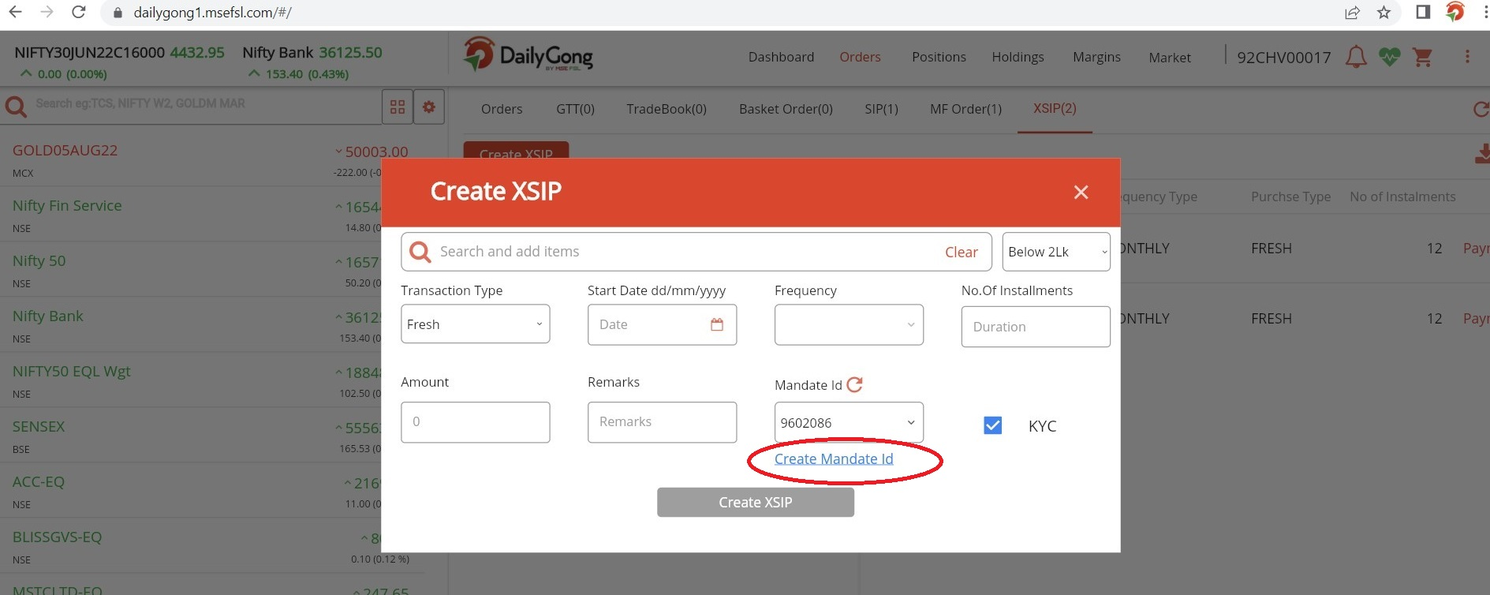
Please Create a new mandate if mandate id is not appearing

Slide 6
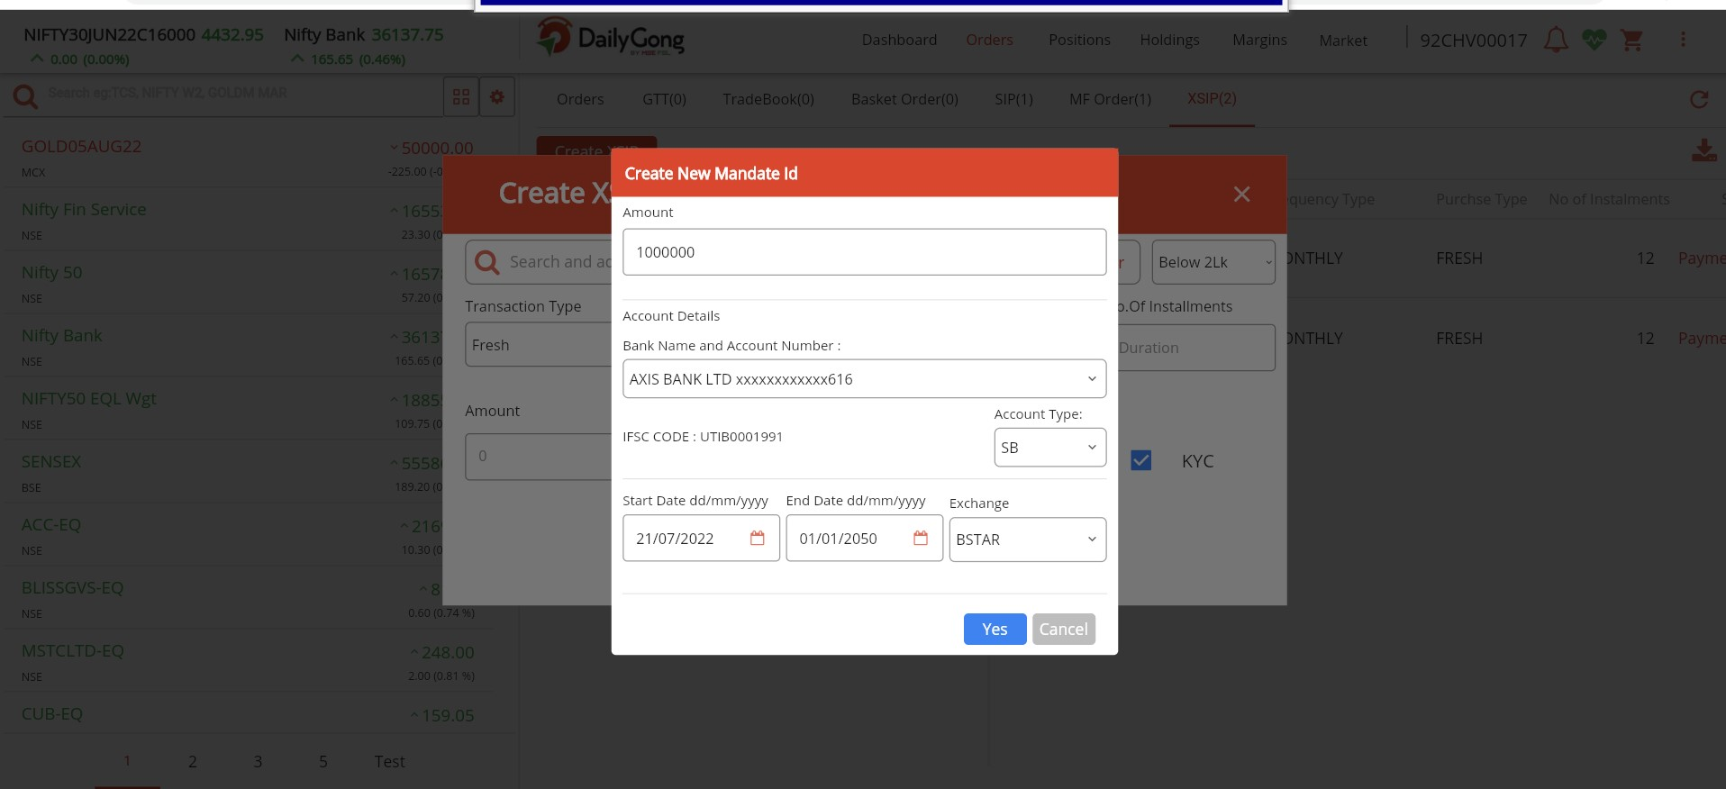

Slide 7
Please Enter the mandate amount as 10 lakh , 20 lakh this column describes the Maximum amount can be debited from the account not the SIP amount.
By Clicking up on submit. Mandate registration email will be sent to the registered email. Users has to authorize it with their Netbanking login

Slide 8
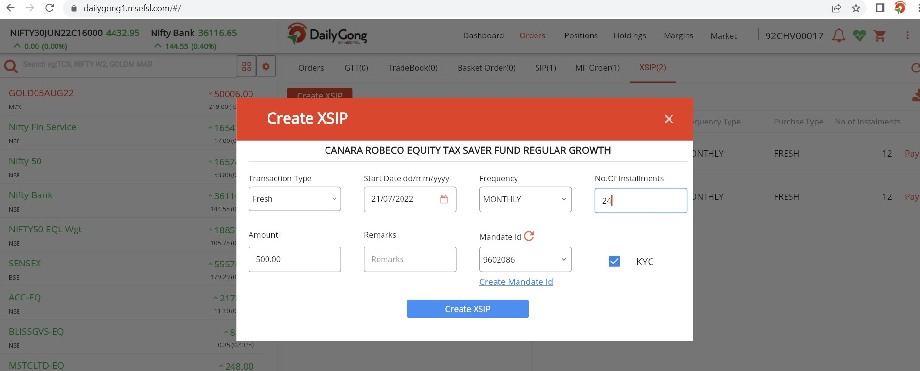

Slide 9
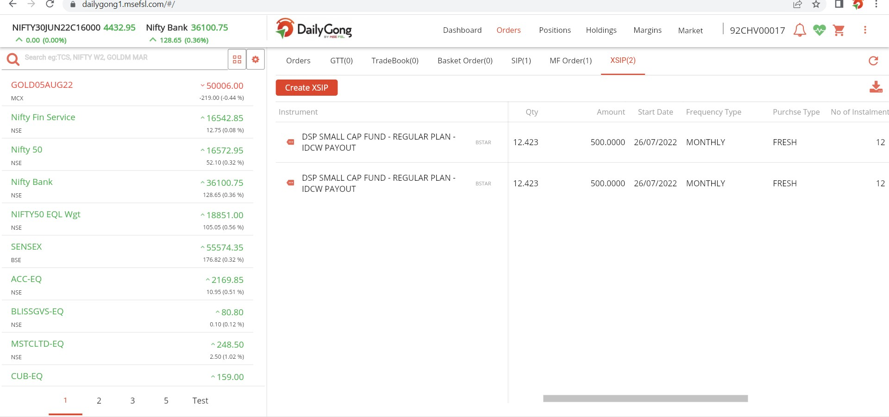

Slide 10
After completing the SIP Registration PAYMENT LINK will be received in the registered email.

