Slide 1

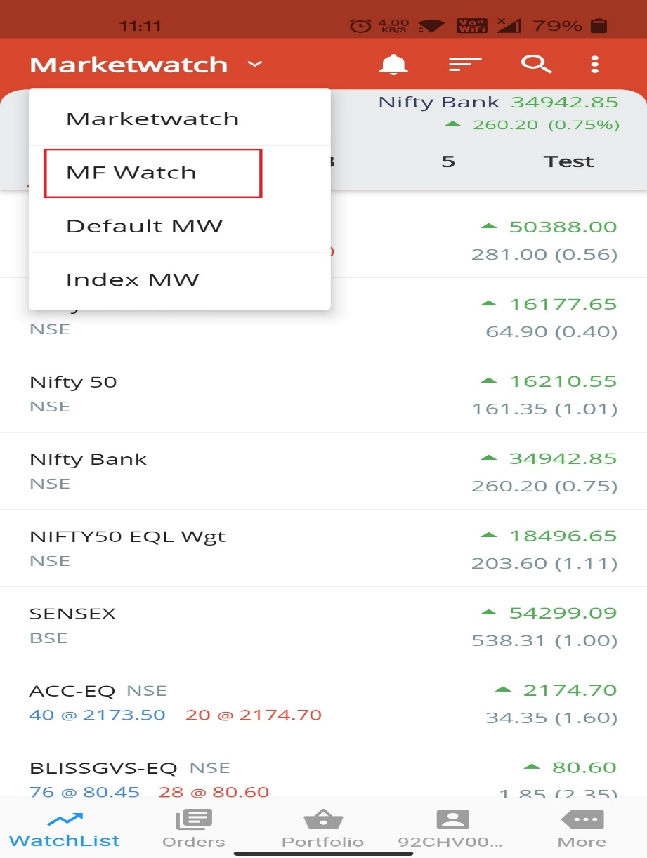
Mutual Fund Lump Sum & SIP Guide
LUMP SUM
Click on Marketwatch → MF Watch

Slide 2
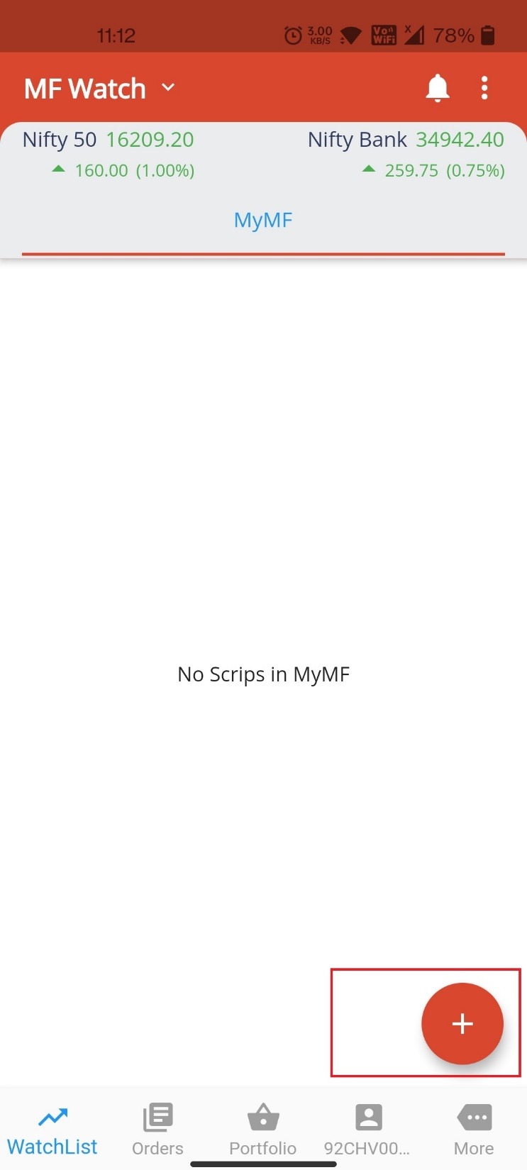
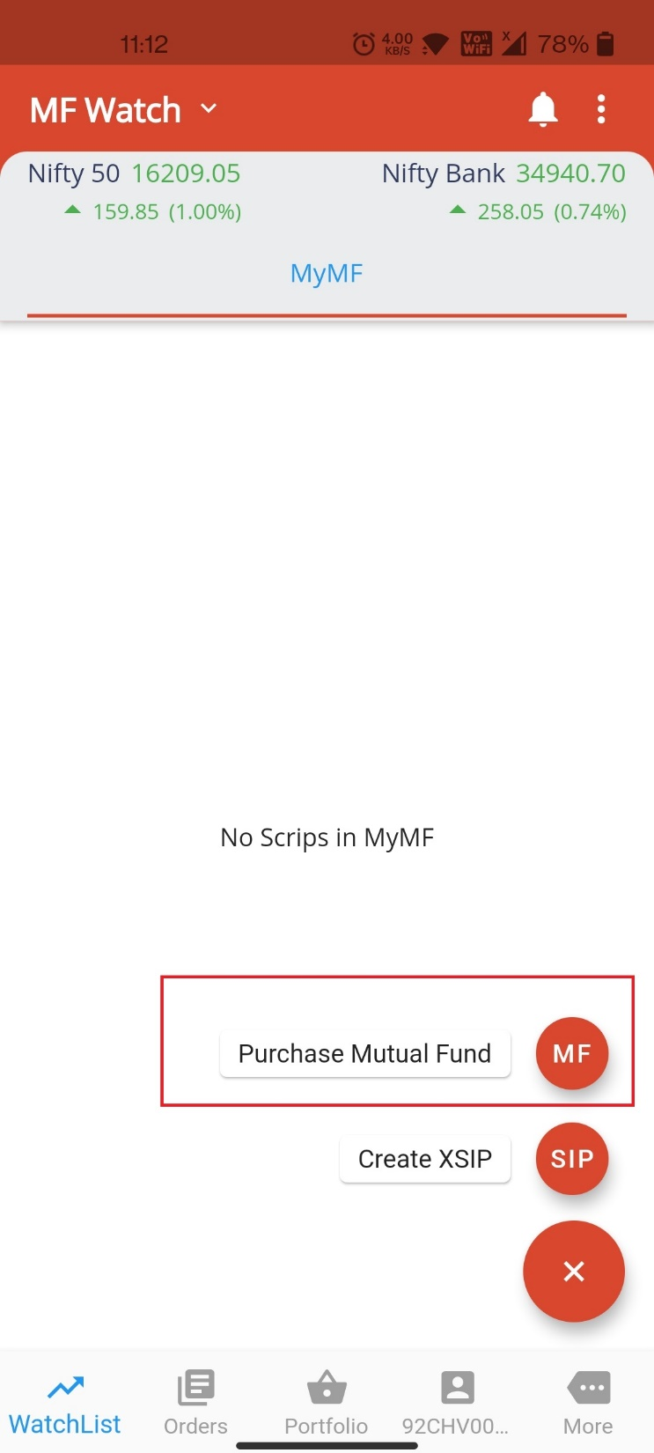

Slide 3
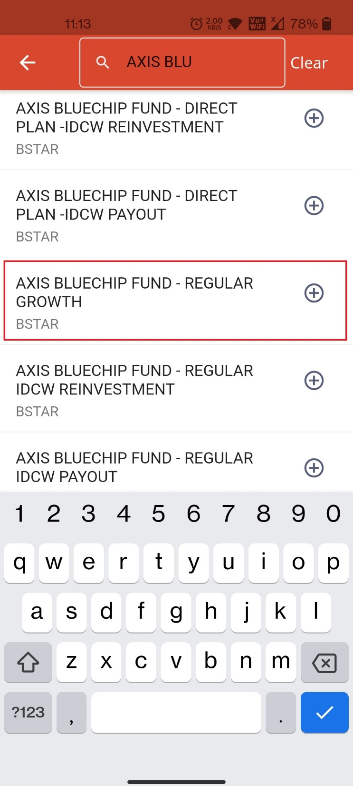
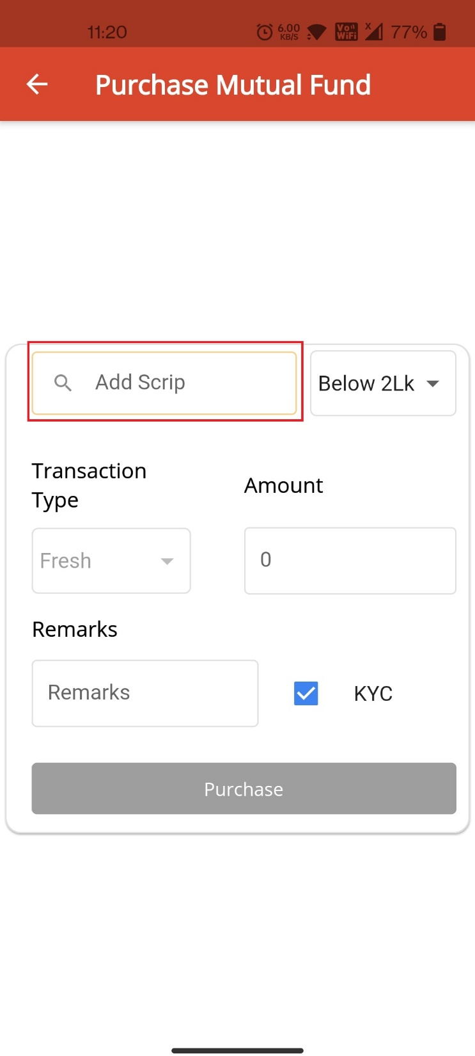

Slide 4
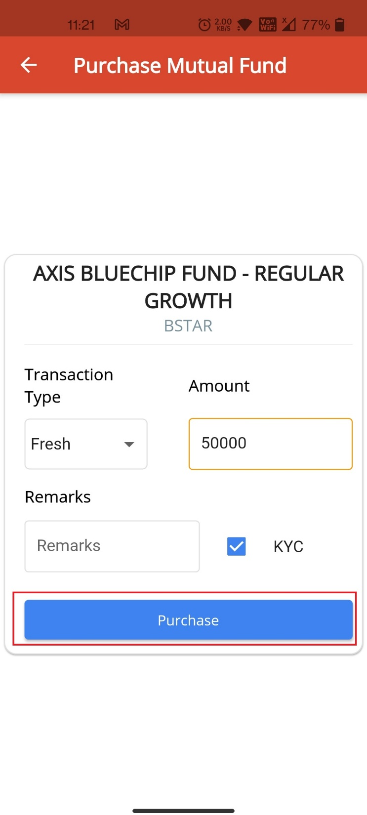

Slide 5
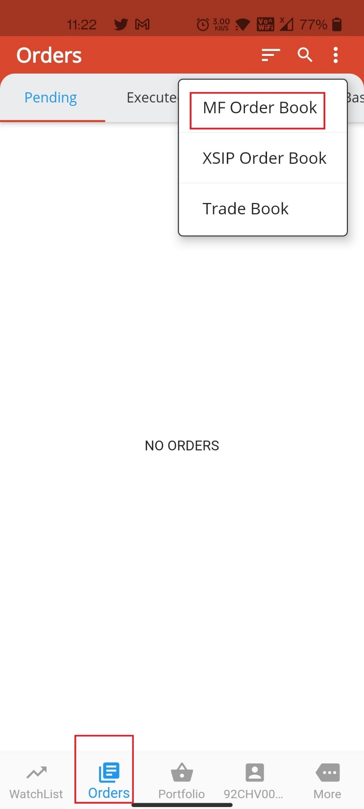
Go to ORDERS → | MF Order Book to get the order status and Make Payment

Slide 6
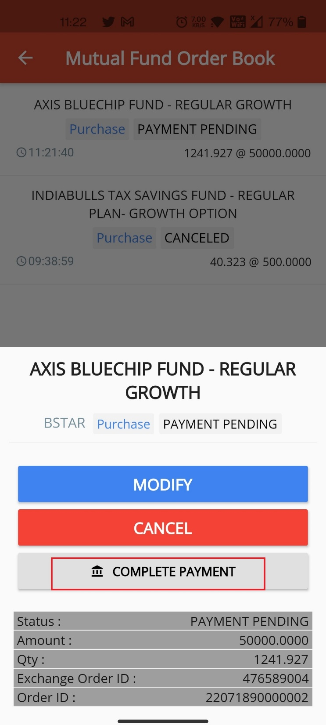

Slide 7
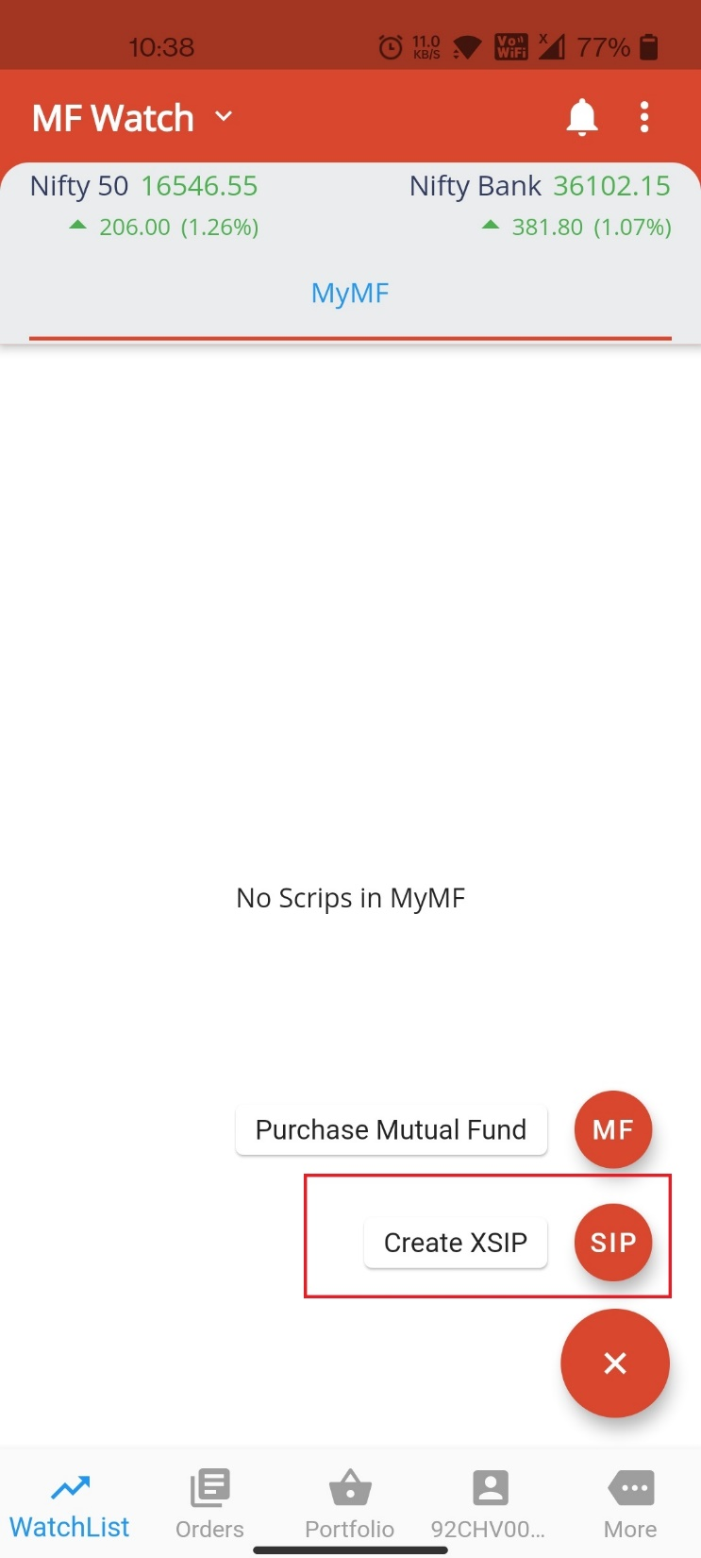
SIP REGISTRATION

Slide 8
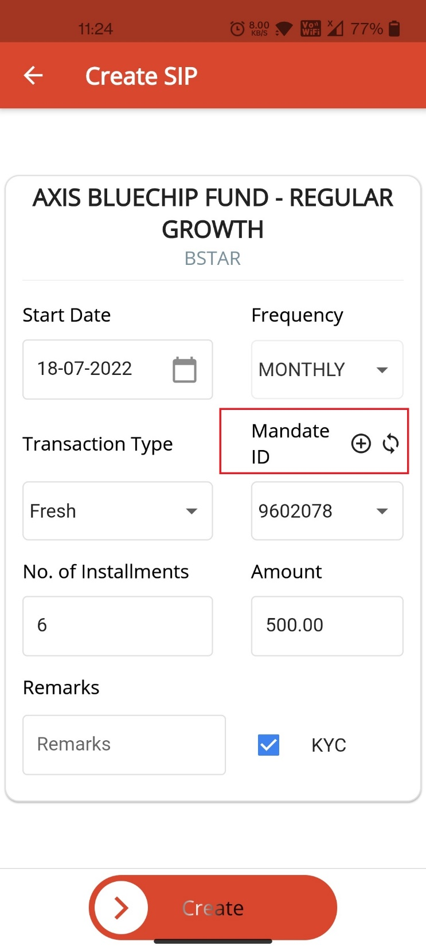
CLICK ON THE Mandate + symbol to register a mandate

Slide 9
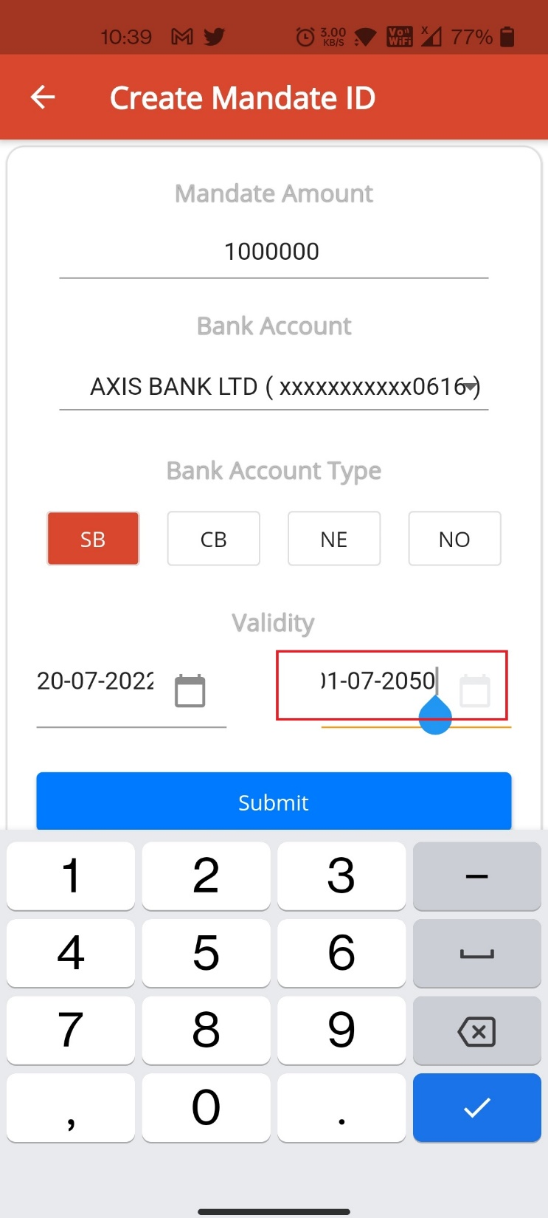
Please Enter the mandate amount as 10 lakh , 20 lakh this column describes the Maximum amount can be debited from the account not the SIP amount.
By Clicking up on submit. Mandate registration email will be sent to the registered email. Users has to authorize it with their Netbanking login

Slide 10
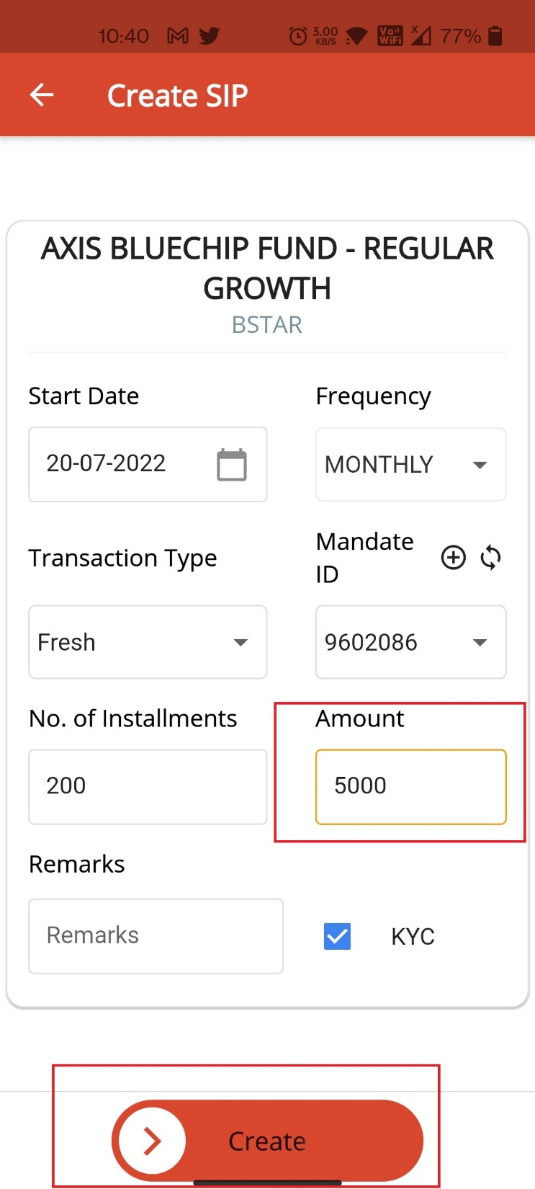

Slide 11
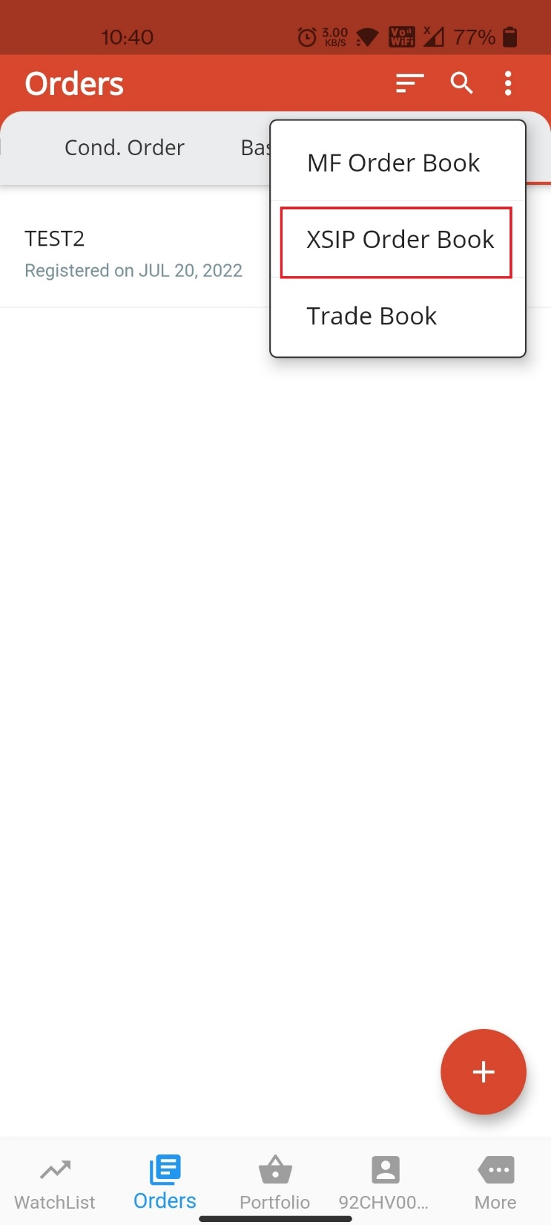
Please click Orders → XSIP orders to check the order status and make payment.

